Slide 1

STM32 Dist.
Micro201

Slide 2

5. BSP package
5
FMC SDRAM BSP lab (5.1)
LCD BSP Print text lab (5.2)
I2C BSP EEPROM lab (5.3)
SPI BSP GYROSCOPE lab (5.4)

Slide 3
5.1 BSP SDRAM lab

Slide 4
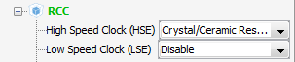
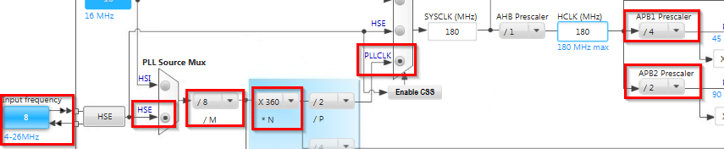
Use BSP for SDRAM initialization
5.1
Create project in CubeMX
Menu > File > New Project
Select STM32F4 > STM32F429/439 > LQFP144 > STM32F439ZITx
We need only blank project with clock initialization
We only set the RCC and configure the core to maximum speed

Slide 5
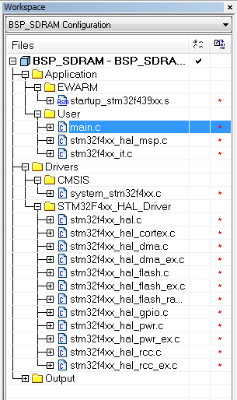
Use BSP for SDRAM initialization
5.1
Now we have bank project
For SDRAM we need to include more parts
Our project
BSP package
Discovery drivers
stm32f4xx_discovery.c
stm32f4xx_discovery_sdram.c
stm32f4xx_discovery_io.c
Components
ili9341.c
lis3dsh.c
stmpe811.c
HAL API
stm32f4xx_II_fmc.c
stm32f4xx_hal_sdram.c
stm32f4xx_hal.c
stm32f4xx_hal_spi.c
stm32f4xx_hal_i2c.c

Slide 6
Use BSP for SDRAM initialization
5.1
BSP SDRAM organization
Our project
BSP package
Discovery drivers
stm32f4xx_discovery.c
stm32f4xx_discovery_sdram.c
stm32f4xx_discovery_io.c
Components
ili9341.c
lis3dsh.c
stmpe811.c
HAL API
stm32f4xx_II_fmc.c
stm32f4xx_hal_sdram.c
stm32f4xx_hal.c
stm32f4xx_hal_spi.c
stm32f4xx_hal_i2c.c

Slide 7
Use BSP for SDRAM initialization
5.1
BSP SDRAM organization
1. include stm32f4xx_discovery_sdram.h
Our project
BSP package
Discovery drivers
stm32f4xx_discovery.c
stm32f4xx_discovery_sdram.c
stm32f4xx_discovery_io.c
Components
2. include stm32f4xx_discovery.h
ili9341.c
lis3dsh.c
stmpe811.c
HAL API
stm32f4xx_II_fmc.c
stm32f4xx_hal_sdram.c
stm32f4xx_hal.c
stm32f4xx_hal_spi.c
stm32f4xx_hal_i2c.c

Slide 8
Use BSP for SDRAM initialization
5.1
BSP SDRAM organization
Our project
3. include stm32f4xx_hal.h
BSP package
Discovery drivers
stm32f4xx_discovery.c
stm32f4xx_discovery_sdram.c
stm32f4xx_discovery_io.c
4. stm32f4xx_hal.h include all peripherals which are used in stm32f4xx_discovery.c
Components
ili9341.c
lis3dsh.c
stmpe811.c
HAL API
stm32f4xx_II_fmc.c
stm32f4xx_hal_sdram.c
stm32f4xx_hal.c
stm32f4xx_hal_spi.c
stm32f4xx_hal_i2c.c

Slide 9
Use BSP for SDRAM initialization
5.1
BSP SDRAM organization
Our project
BSP package
Discovery drivers
stm32f4xx_discovery.c
stm32f4xx_discovery_sdram.c
stm32f4xx_discovery_io.c
5. stm32f4xx_hal.h include all peripherals which are used in stm32f4xx_discovery_sdram.c
Components
ili9341.c
lis3dsh.c
stmpe811.c
HAL API
stm32f4xx_II_fmc.c
stm32f4xx_hal_sdram.c
stm32f4xx_hal.c
stm32f4xx_hal_spi.c
stm32f4xx_hal_i2c.c

Slide 10
Use BSP for SDRAM initialization
5.1
BSP SDRAM organization
6. HAL_SDRAM_Init is function from stm32f4xx_discovery_sdram.c
Our project
7. HAL_SDRAM_Init
call functions from stm32f4xx_II_fmc.c
BSP package
Discovery drivers
stm32f4xx_discovery.c
stm32f4xx_discovery_sdram.c
stm32f4xx_discovery_io.c
Components
8. stm32f4xx_II_fmc.c use functions from stm32f4xx_hal_sdram.c
ili9341.c
lis3dsh.c
stmpe811.c
HAL API
stm32f4xx_II_fmc.c
stm32f4xx_hal_sdram.c
stm32f4xx_hal.c
stm32f4xx_hal_spi.c
stm32f4xx_hal_i2c.c

Slide 11
Use BSP for SDRAM initialization
5.1
Source files
Include files
user_code.c
user_code.h
User Code
stm32f4xx_it.c
stm32f4xx_it.h
Stm32f4xx_discovery.c
Stm32ffxx_discovery_sdram.c
Stm32f4xx_discovery.h
Stm32ffxx_discovery_sdram.h
BSP Drivers
stm32f4xx_hal_ppp.c
stm32f4xx_hal_ppp_ex.c
stm32f4xx_hal.h
HAL Drivers
stm32f4xx_hal_conf.h
stm32f4xx_hal.c
stm32f4xx_hal_ppp.h
stm32f4xx_hal_ppp_ex.h
stm32f4xx_hal_def.h

Slide 12
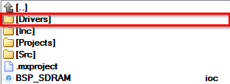
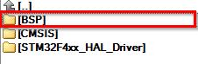
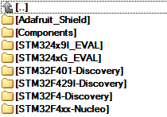
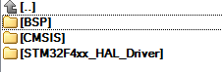
Use BSP for SDRAM initialization
5.1
The copy part
In our project in Drivers folder create folder BSP
Now go into CubeMX repository …\STM32Cube_FW_F4_V1.3.0\Drivers\BSP\
And copy Components and STM32F429I-Discovery into BSP folder
Copy folders into BSP

Slide 13
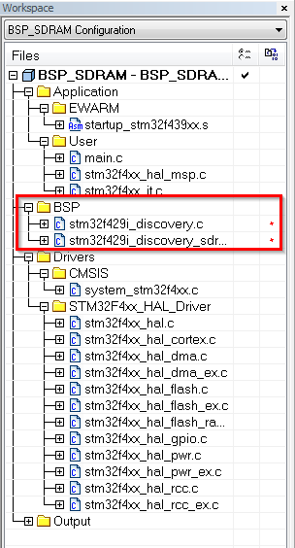
Use BSP for SDRAM initialization
5.1
Now we need to add this files also in project
Create BSP folder in project
Right click on project in Workplace>ADD>Group
Name it BSP
Now right click on BSP>ADD>Files
From Drivers\BSP\STM32F429I-Discovery\ add stm32f429i_discovery.c and stm32f429i_discovery_sdram.c

Slide 14
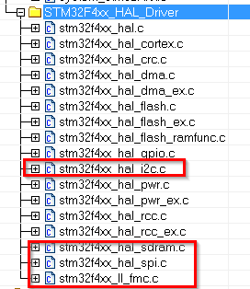
Use BSP for SDRAM initialization
5.1
The stm32f429i_discovery.c contains functions for all components on discovery kit (LCD, GYRO,…)
Then we also need add into project HAL library which handle their interface (I2C, SPI, … )
Right click on STM32F4xx_HAL_Drive>ADD from \Drivers\STM32F4xx_HAL_Driver\Src
stm32f4xx_hal_i2c.c
stm32f4xx_hal_spi.c
stm32f4xx_hal_sdram.c
stm32f4xx_II_fmc.c

Slide 15
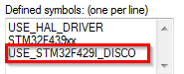
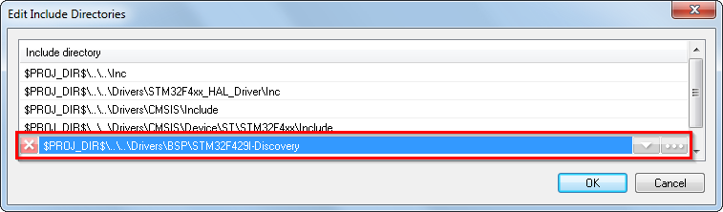
Use BSP for SDRAM initialization
5.1
Now add the include paths for this new files
Right click on project>Options>Category C/C++Compiler>Preprocesor
Into Defined symbols add USE_STM32F429I_DISCO
This allow use BSP functions
Into additional includes add $PROJ_DIR$\..\..\Drivers\BSP\STM32F429I-Discovery
Button OK
Button OK close project options

Slide 16
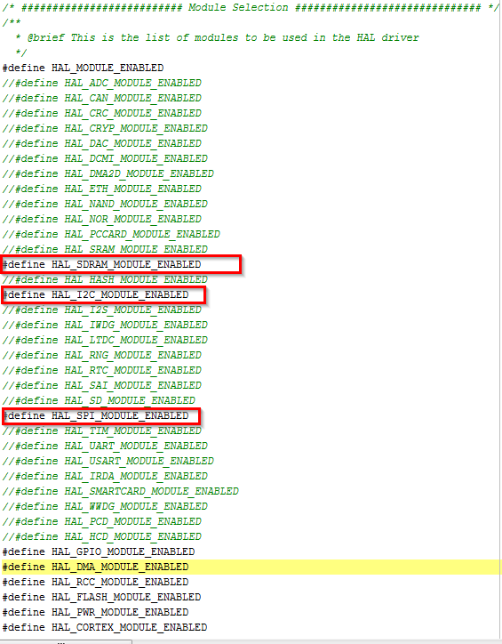
Use BSP for SDRAM initialization
5.1
Now last thing is allow to include new HAL files which we added
Open stm32f4xx_hal_conf.h in ..\Inc\
Uncomment files which we added
HAL_SDRAM_MODULE_ENABLED
HAL_I2C_MODULE_ENABLED
HAL_SPI_MODULE_ENABLED

Slide 17
Use BSP for LCD init and writing
5.2
BSP LCD organization
Our project
BSP package
Discovery drivers
stm32f4xx_discovery.c
stm32f4xx_discovery_lcd.c
stm32f4xx_discovery_sdram.c
Components
Utilities
ili9341.c
lis3dsh.c
stmpe811.c
Fonts
HAL API
stm32f4xx_hal_sdram.c
stm32f4xx_hal_ltdc.c
stm32f4xx_hal.c
stm32f4xx_hal_spi.c
stm32f4xx_II_fmc.c
stm32f4xx_hal_i2c.c

Slide 18
Use BSP for LCD init and writing
5.2
BSP LCD organization
1. include stm32f4xx_discovery_lcd.h
Our project
BSP package
Discovery drivers
stm32f4xx_discovery.c
stm32f4xx_discovery_lcd.c
stm32f4xx_discovery_sdram.c
2. stm32f4xx_discovery_lcd.h use the discovery BSP and SDRAM
Components
Utilities
ili9341.c
lis3dsh.c
stmpe811.c
Fonts
HAL API
stm32f4xx_hal_sdram.c
stm32f4xx_hal_ltdc.c
stm32f4xx_hal.c
stm32f4xx_hal_spi.c
stm32f4xx_II_fmc.c
stm32f4xx_hal_i2c.c

Slide 19
Use BSP for LCD init and writing
5.2
BSP LCD organization
Our project
3. stm32f4xx_discovery_lcd.h use driver ili9341.c which is TFT LCD controller
BSP package
Discovery drivers
stm32f4xx_discovery.c
stm32f4xx_discovery_lcd.c
stm32f4xx_discovery_sdram.c
Components
Utilities
4. stm32f4xx_discovery_lcd.h use LCTD controller from HAL
ili9341.c
lis3dsh.c
stmpe811.c
Fonts
HAL API
stm32f4xx_hal_sdram.c
stm32f4xx_hal_ltdc.c
stm32f4xx_hal.c
stm32f4xx_hal_spi.c
stm32f4xx_II_fmc.c
stm32f4xx_hal_i2c.c

Slide 20
Use BSP for LCD init and writing
5.2
BSP LCD organization
Our project
BSP package
Discovery drivers
stm32f4xx_discovery.c
stm32f4xx_discovery_lcd.c
stm32f4xx_discovery_sdram.c
Components
Utilities
2. stm32f4xx_discovery_lcd.h use fonts from utility folder
ili9341.c
lis3dsh.c
stmpe811.c
Fonts
HAL API
stm32f4xx_hal_sdram.c
stm32f4xx_hal_ltdc.c
stm32f4xx_hal.c
stm32f4xx_hal_spi.c
stm32f4xx_II_fmc.c
stm32f4xx_hal_i2c.c

Slide 21
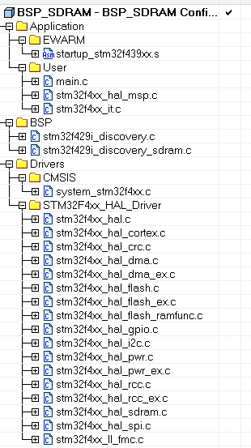
Use BSP for LCD init and writing
5.2
We use the project from BSP SDRAM because the LCD also use the SDRAM
We need copy the Fonts from Utilities folder in CubeMX repository

Slide 22
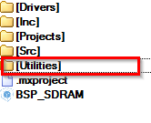
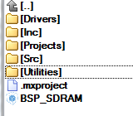
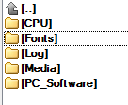
Use BSP for LCD init and writing
5.2
The copy part
In our project in Drivers folder create folder Utilities
Now go into CubeMX repository …\STM32Cube_FW_F4_V1.3.0\Utilities\
And copy Fonts into Utilities folder
Copy folders into Utilities

Slide 23
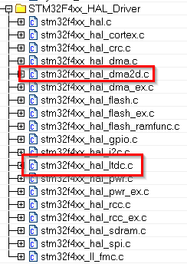
Use BSP for LCD init and writing
5.2
We add the driver for LCD from HAL
Right click on STM32F4xx_HAL_Drive>ADD from \Drivers\STM32F4xx_HAL_Driver\Src
stm32f4xx_hal_ltdc.c
Stm32f4xx_hal_dma2d.c

Slide 24
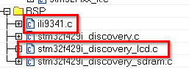
Use BSP for LCD init and writing
5.2
We add the driver for BSP LDC
Right click on BSP>ADD from \Drivers\BSP\STM32F429I-Discovery\
stm32f429i_discovery_lcd.c
Right click on BSP>ADD from \Drivers\BSP\Components\ili9341\
ili9341.c

Slide 25
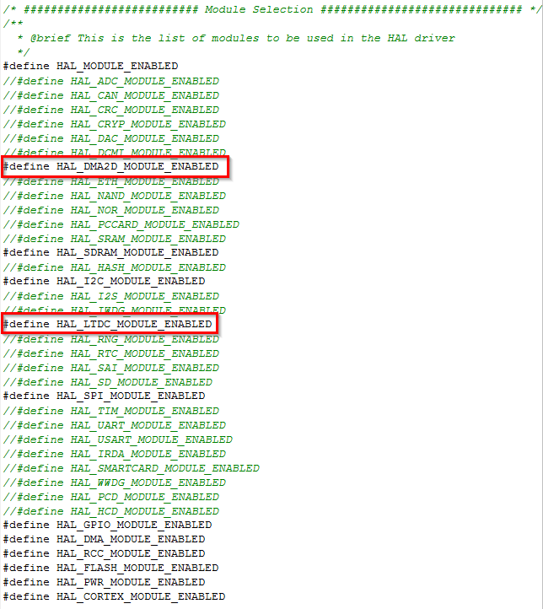
Use BSP for LCD init and writing
5.2
Now last thing is allow to include new HAL files which we added
Open stm32f4xx_hal_conf.h in ..\Inc\
Uncomment files which we added
HAL_DMA2D_MODULE_ENABLED
HAL_LTDC_MODULE_ENABLED

Slide 26
Use BSP for LCD init and writing
5.2
Into main.c now we modify include from stm32f429i_discovery_sdram.h to stm32f429i_discovery_lcd.h
And remove the BSP_SDRAM_Init()
/* USER CODE BEGIN Includes */
#include "stm32f429i_discovery_lcd.h"
/* USER CODE END Includes */
/* USER CODE BEGIN 2 */
/* USER CODE END 2 */

Slide 27
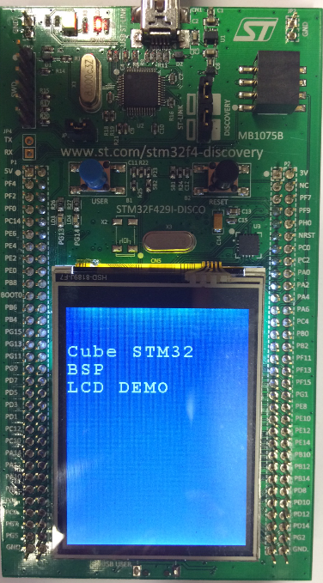
Use BSP for LCD init and writing
5.2
Simple LCD demonstration
/* USER CODE BEGIN 2 */
BSP_LCD_Init();//init LCD
//set the layer buffer address into SDRAM
BSP_LCD_LayerDefaultInit(1, SDRAM_DEVICE_ADDR);
BSP_LCD_SelectLayer(1);//select on which layer we write
BSP_LCD_DisplayOn();//turn on LCD
BSP_LCD_Clear(LCD_COLOR_BLUE);//clear the LCD on blue color
BSP_LCD_SetBackColor(LCD_COLOR_BLUE);//set text background color
BSP_LCD_SetTextColor(LCD_COLOR_WHITE);//set text color
//write text
BSP_LCD_DisplayStringAtLine(2,"Cube STM32");
BSP_LCD_DisplayStringAtLine(3,"BSP");
BSP_LCD_DisplayStringAtLine(4,"LCD DEMO");
/* USER CODE END 2 */

Slide 28
5.3 BSP EEPROM lab

Slide 29
Use BSP to access EEPROM
5.3
Objective
Learn how import BSP EEPROM into project
We use the project from lab 26
Which part need to by configured in GUI
Try to write text into EEPROM and read it
Read text from EEPROM and display it on LCD
Goal
Successfully import BSP EEPROM drivers into your project
Learn which part you need to import
How to setup the project

Slide 30
Use BSP to access EEPROM
5.3
BSP EEPROM organization
Our project
BSP package
Discovery drivers
stm32f4xx_discovery_lcd.c
stm32f4xx_discovery_io.c
stm32f4xx_discovery_eeprom.c
stm32f4xx_discovery_sdram.c
stm32f4xx_discovery.c
Components
Utilities
ili9341.c
lis3dsh.c
stmpe811.c
Fonts
HAL API
stm32f4xx_hal_sdram.c
stm32f4xx_hal_ltdc.c
stm32f4xx_hal.c
stm32f4xx_hal_spi.c
stm32f4xx_II_fmc.c
stm32f4xx_hal_i2c.c

Slide 31
Use BSP to access EEPROM
5.3
BSP EEPROM organization
1. Use functions from stm32f4xx_discovery_eeprom.c
Our project
BSP package
Discovery drivers
stm32f4xx_discovery_lcd.c
stm32f4xx_discovery_io.c
stm32f4xx_discovery_eeprom.c
stm32f4xx_discovery_sdram.c
stm32f4xx_discovery.c
Components
Utilities
ili9341.c
lis3dsh.c
stmpe811.c
Fonts
HAL API
stm32f4xx_hal_sdram.c
stm32f4xx_hal_ltdc.c
stm32f4xx_hal.c
stm32f4xx_hal_spi.c
stm32f4xx_II_fmc.c
stm32f4xx_hal_i2c.c

Slide 32
Use BSP to access EEPROM
5.3
BSP SDRAM organization
2. stm32f4xx_discovery_eeprom.c call functions from stm32f4xx_discovery_io.c
Our project
BSP package
Discovery drivers
stm32f4xx_discovery_lcd.c
stm32f4xx_discovery_io.c
stm32f4xx_discovery_eeprom.c
stm32f4xx_discovery_sdram.c
stm32f4xx_discovery.c
3. stm32f4xx_discovery_io.c call functions from stm32f4xx_discovery.c
pin init and write/read functions
Components
Utilities
ili9341.c
lis3dsh.c
stmpe811.c
Fonts
HAL API
stm32f4xx_hal_sdram.c
stm32f4xx_hal_ltdc.c
stm32f4xx_hal.c
stm32f4xx_hal_spi.c
stm32f4xx_II_fmc.c
stm32f4xx_hal_i2c.c

Slide 33
Use BSP to access EEPROM
5.3
BSP EEPROM organization
Our project
BSP package
Discovery drivers
stm32f4xx_discovery_lcd.c
stm32f4xx_discovery_io.c
stm32f4xx_discovery_eeprom.c
stm32f4xx_discovery_sdram.c
stm32f4xx_discovery.c
Components
4. stm32f4xx_discovery.c
Use stm32f4xx_hal_i2c to commutate with eeprom memory
Utilities
ili9341.c
lis3dsh.c
stmpe811.c
Fonts
HAL API
stm32f4xx_hal_sdram.c
stm32f4xx_hal_ltdc.c
stm32f4xx_hal.c
stm32f4xx_hal_spi.c
stm32f4xx_II_fmc.c
stm32f4xx_hal_i2c.c

Slide 34
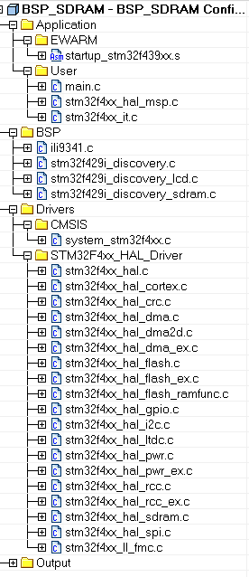
Use BSP to access EEPROM
5.3
We use the project from BSP LCD lab 26 because we want to display the memory content on LCD

Slide 35
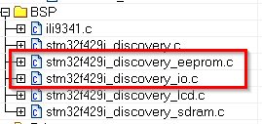
Use BSP to access EEPROM
5.3
We add the driver for BSP LDC
Right click on BSP>ADD from \Drivers\BSP\STM32F429I-Discovery\
stm32f429i_discovery_eeprom.c
stm32f429i_discovery_io.c

Slide 36
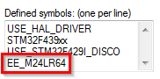
Use BSP to access EEPROM
5.3
Add the define of EEPROM into project options
Right click on project>Options>Category C/C++Compiler>Preprocesor
Into Defined symbols add EE_M24LR64
This allow use EEPROM functions
Button OK close project options

Slide 37
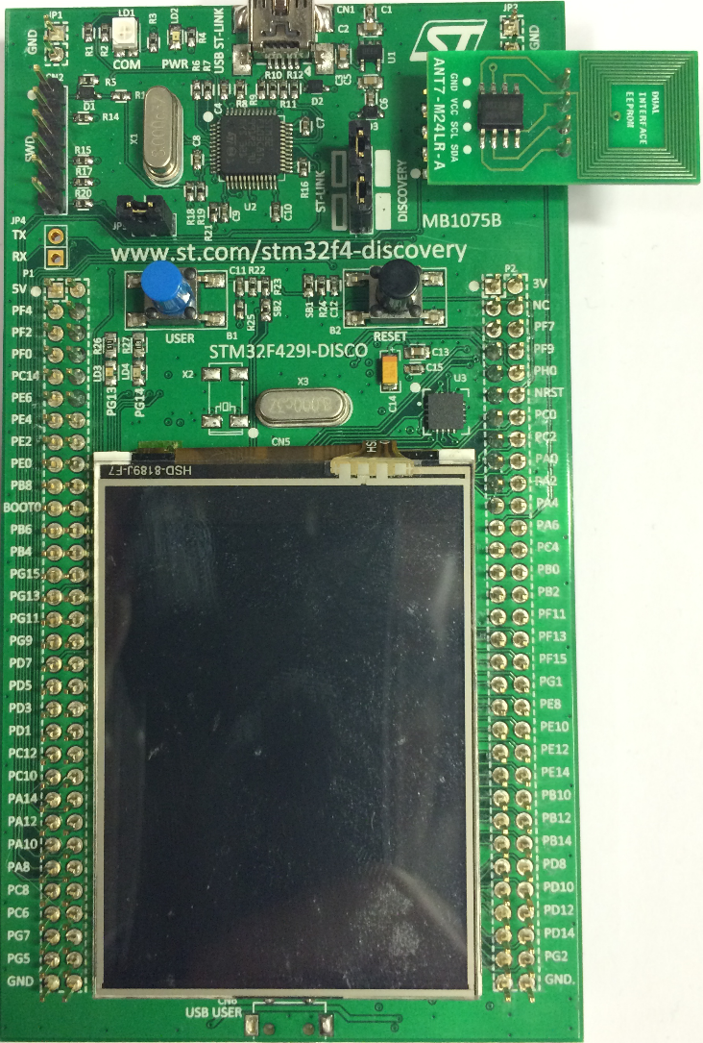
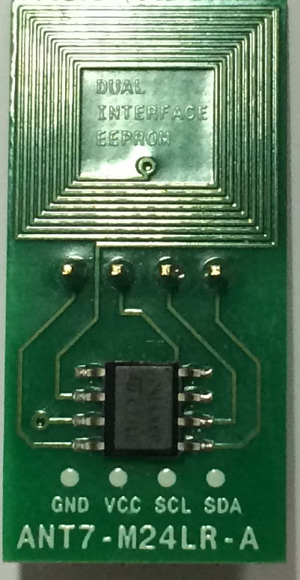
Use BSP to access EEPROM
5.3
Use the ATM7-M24LR-A board with M24LR memory and connect it into STM32F429i-Discovery kit

Slide 38
Use BSP to access EEPROM
5.3
Into main.c now modify include
Define variables
/* USER CODE BEGIN Includes */
#include "stm32f429i_discovery_lcd.h"
#include "stm32f429i_discovery_io.h"
#include "stm32f429i_discovery_eeprom.h"
#include <string.h>
/* USER CODE END Includes */
/* USER CODE BEGIN PV */
uint8_t text_to_write[]="test text";//write to eeprom
uint8_t text_to_read[200];//read from eeprom
uint32_t address=0;//address in eeprom
uint16_t read_num=1;//number of bytes which we want to read from eeprom
/* USER CODE END PV */

Slide 39
Use BSP to access EEPROM
5.3
Into stm32f4xx_it.c add global variable for i2c handle
and define handler functions for I2C DMA
/* USER CODE BEGIN 0 */
extern I2C_HandleTypeDef I2cHandle;
/* USER CODE END 0 */
/* USER CODE BEGIN 1 */
void DMA1_Stream4_IRQHandler()
{
HAL_DMA_IRQHandler(I2cHandle.hdmatx);
}
void DMA1_Stream2_IRQHandler()
{
HAL_DMA_IRQHandler(I2cHandle.hdmarx);
}
/* USER CODE END 1 */

Slide 40
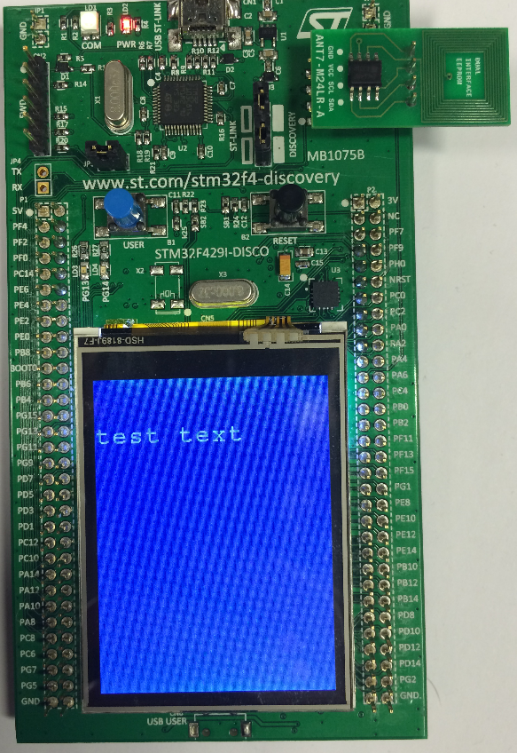
Use BSP to access EEPROM
5.3
Into main.c add
/* USER CODE BEGIN 2 */
/*LCD init*/
BSP_LCD_Init();
BSP_LCD_LayerDefaultInit(1, SDRAM_DEVICE_ADDR);
BSP_LCD_SelectLayer(1);
BSP_LCD_DisplayOn();
BSP_LCD_Clear(LCD_COLOR_BLUE);
BSP_LCD_SetBackColor(LCD_COLOR_BLUE);
BSP_LCD_SetTextColor(LCD_COLOR_WHITE);
/*EEPROM init*/
BSP_EEPROM_Init();
/*Write text into EEPROM*/
BSP_EEPROM_WriteBuffer(text_to_write,0,(strlen(text_to_write)+1));
/*Read text from EEPROM*/
do{
BSP_EEPROM_ReadBuffer((uint8_t*)&(text_to_read[address]),address,(uint16_t*)&read_num);
}while(text_to_read[address++]!=0x0);
/*Display text*/
BSP_LCD_DisplayStringAtLine(2,text_to_read);
/* USER CODE END 2 */

Slide 41
5.4 BSP GYRO lab

Slide 42
Use BSP to access GYROSCOPE
5.4
Objective
Learn how import BSP GYROSCOPE into project
We use the project from lab 26
Which part need to by configured in GUI
Read data from GYROSCOPE and display it on LCD
Goal
Successfully import BSP GYROSCOPE drivers into your project
Learn which part you need to import
How to setup the project

Slide 43
Use BSP to access GYROSCOPE
5.4
BSP GYRO organization
Our project
BSP package
Discovery drivers
stm32f4xx_discovery_lcd.c
stm32f4xx_discovery_io.c
stm32f4xx_discovery_gyroscope.c
stm32f4xx_discovery_sdram.c
stm32f4xx_discovery.c
Components
Utilities
ili9341.c
lis3dsh.c
stmpe811.c
Fonts
HAL API
stm32f4xx_hal_sdram.c
stm32f4xx_hal_ltdc.c
stm32f4xx_hal.c
stm32f4xx_hal_spi.c
stm32f4xx_II_fmc.c
stm32f4xx_hal_i2c.c

Slide 44
Use BSP to access GYROSCOPE
5.4
BSP GYRO organization
1. Use functions from stm32f4xx_discovery_eeprom.c
Our project
BSP package
Discovery drivers
stm32f4xx_discovery_lcd.c
stm32f4xx_discovery_io.c
stm32f4xx_discovery_gyroscope.c
stm32f4xx_discovery_sdram.c
stm32f4xx_discovery.c
Components
Utilities
ili9341.c
lis3dsh.c
stmpe811.c
Fonts
HAL API
stm32f4xx_hal_sdram.c
stm32f4xx_hal_ltdc.c
stm32f4xx_hal.c
stm32f4xx_hal_spi.c
stm32f4xx_II_fmc.c
stm32f4xx_hal_i2c.c

Slide 45
Use BSP to access GYROSCOPE
5.4
BSP GYRO organization
2. stm32f4xx_discovery_gyroscope.c call functions from stm32f4xx_discovery_io.c
Our project
BSP package
Discovery drivers
stm32f4xx_discovery_lcd.c
stm32f4xx_discovery_io.c
stm32f4xx_discovery_gyroscope.c
stm32f4xx_discovery_sdram.c
stm32f4xx_discovery.c
3. stm32f4xx_discovery_io.c call functions from stm32f4xx_discovery.c
pin init and read functions
Components
Utilities
ili9341.c
lis3dsh.c
stmpe811.c
Fonts
HAL API
stm32f4xx_hal_sdram.c
stm32f4xx_hal_ltdc.c
stm32f4xx_hal.c
stm32f4xx_hal_spi.c
stm32f4xx_II_fmc.c
stm32f4xx_hal_i2c.c

Slide 46
Use BSP to access GYROSCOPE
5.4
BSP GYRO organization
Our project
BSP package
Discovery drivers
stm32f4xx_discovery_lcd.c
stm32f4xx_discovery_io.c
stm32f4xx_discovery_gyroscope.c
stm32f4xx_discovery_sdram.c
stm32f4xx_discovery.c
Components
4. stm32f4xx_discovery.c
Use stm32f4xx_hal_spi to commutate with gyroscope
Utilities
ili9341.c
lis3dsh.c
stmpe811.c
Fonts
HAL API
stm32f4xx_hal_sdram.c
stm32f4xx_hal_ltdc.c
stm32f4xx_hal.c
stm32f4xx_hal_spi.c
stm32f4xx_II_fmc.c
stm32f4xx_hal_i2c.c

Slide 47
Use BSP to access GYROSCOPE
5.4
We use the project from BSP LCD lab 26 because we want to display gyro values on LCD

Slide 48
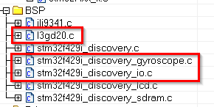
Use BSP to access GYROSCOPE
5.4
We add the driver for BSP LDC
Right click on BSP>ADD from \Drivers\BSP\STM32F429I-Discovery\
stm32f429i_discovery_gyroscope.c
stm32f429i_discovery_io.c
Right click on BSP>ADD from \Drivers\BSP\Components\
l3gd20.c

Slide 49
Use BSP to access GYROSCOPE
5.4
Into main.c now modify include
Define variables
/* USER CODE BEGIN Includes */
#include "stm32f429i_discovery_lcd.h"
#include "stm32f429i_discovery_gyroscope.h"
#include "stm32f429i_discovery_io.h"
#include <stdio.h>
/* USER CODE END Includes */
/* USER CODE BEGIN PV */
float valxyz[3];//gyroscope values
uint8_t buffer[200];//text buffer
/* USER CODE END PV */

Slide 50
Use BSP to access GYROSCOPE
5.4
Into main.c add
/* USER CODE BEGIN 2 */
/*LCD init*/
BSP_LCD_Init();
BSP_LCD_LayerDefaultInit(1, SDRAM_DEVICE_ADDR);
BSP_LCD_SelectLayer(1);
BSP_LCD_DisplayOn();
BSP_LCD_Clear(LCD_COLOR_BLUE);
BSP_LCD_SetBackColor(LCD_COLOR_BLUE);
BSP_LCD_SetTextColor(LCD_COLOR_WHITE);
/*Gyroscope init*/
BSP_GYRO_Init();
/* USER CODE END 2 */

Slide 51
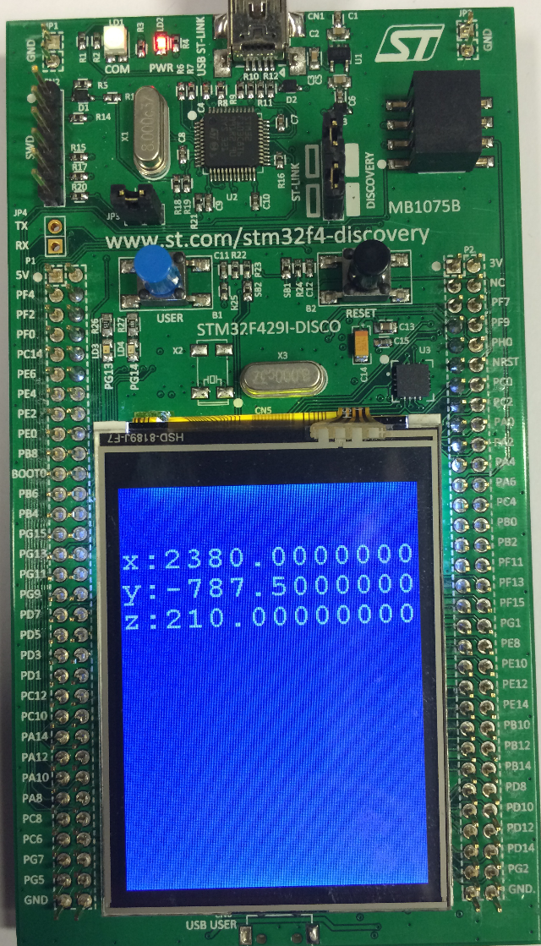
Use BSP to access GYROSCOPE
5.4
Into main.c add
/* USER CODE BEGIN 3 */
/* Infinite loop */
while (1)
{
/*Get Gyrospope value*/
BSP_GYRO_GetXYZ(valxyz);
/*Display X*/
sprintf(buffer,"x:%f",valxyz[0]);
BSP_LCD_DisplayStringAtLine(2,buffer);
/*Display Y*/
sprintf(buffer,"y:%f",valxyz[1]);
BSP_LCD_DisplayStringAtLine(3,buffer);
/*Display Z*/
sprintf(buffer,"z:%f",valxyz[2]);
BSP_LCD_DisplayStringAtLine(4,buffer);
/*Delay*/
HAL_Delay(1000);
}
/* USER CODE END 3 */

Slide 52
www.st.com/stm32

